Slide 1
Pandas

Slide 2
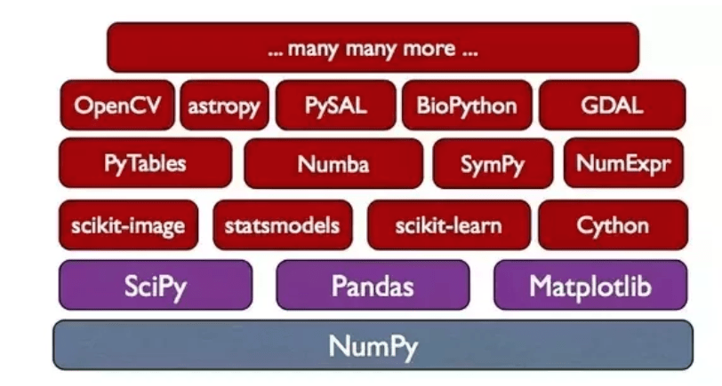

Slide 3
Numpy
NumPy is the fundamental package for scientific computing with Python. It contains among other things:
a powerful N-dimensional array object
sophisticated (broadcasting) functions
useful linear algebra, Fourier transform, and random number capabilities
Besides its obvious scientific uses, NumPy can also be used as an efficient multi-dimensional container of generic data. Arbitrary data-types can be defined. This allows NumPy to seamlessly and speedily integrate with a wide variety of databases.

Slide 4
Numpy array
1-D array
9 | 14 | 3 | 2 | 5 | 10 | 4 | 3 | 1 | 0

Slide 5
2-D array
5 | 7 | 9 | 7
4 | 3 | 1 | 2
2 | 4 | 3 | 1
6 | 5 | 8 | 3

Slide 6
Indexed Numpy array
A | B | C | D | E | F | G | H | I | J
9 | 14 | 3 | 2 | 5 | 10 | 4 | 3 | 1 | 0

Slide 7
2-D array
5 | 7 | 9 | 7
4 | 3 | 1 | 2
2 | 4 | 3 | 1
6 | 5 | 8 | 3

Slide 8
Labeled 2-D array
 | A | B | C | D
One | 5 | 7 | 9 | 7
Two | 4 | 3 | 1 | 2
Three | 2 | 4 | 3 | 1
Four | 6 | 5 | 8 | 3

Slide 9
Series
A | B | C | D | E | F | G | H | I | J
9 | 14 | 3 | 2 | 5 | 10 | 4 | 3 | 1 | 0
DataFrame
 | A | B | C | D
One | 5 | 7 | 9 | 7
Two | 4 | 3 | 1 | 2
Three | 2 | 4 | 3 | 1
Four | 6 | 5 | 8 | 3

Slide 10
Dictionary
+
Numpy array
Pandas

